Slide 1
File System Management File System Case Studies (NOT EXAMINABLE)
Lecture 12 (Live Version)

Slide 2
Overview
Microsoft FAT File System
Layout
Partition Information
Directory Structure
Linux Ext2 File System
Layout
Partition Information
I-Node
Directory Structure
Extra topics

Slide 3
Microsoft FAT File System
Brief history:
Used in MS-DOS starting in 1980s
Shipped as default file system until Windows XP (2001)
Several major versions:
FAT12 ➔ FAT16 ➔ FAT32
FAT32 still very popular:
Supported across all major OSes
Portable drives, gaming console, digital camera, etc
Simple and serves as a good introduction

Slide 4
Microsoft FAT File System Layout
M B R
partition 1
partition 2
partition 3
partition 4
FAT
FAT
Duplicate
optional
Boot
root
directory
data blocks
Notes:
Root no longer fixed in FAT32. Root can be understood as just a normal data block in a special location

Slide 5
File Data and File Allocation Table
File data are allocated to:
A number of data blocks / data block clusters
Allocation info is kept as a linked list
All data block pointers kept separately in the File Allocation Table
File Allocation Table (FAT):
One entry per data block/cluster
Store disk block information
Free? Next block (if occupied)? Damaged?
OS will cache in RAM to facilitate linked list traversal

Slide 6
File Allocation Table
Boot
FAT
FAT
Duplicate
data blocks
0
1
BAD
2
EOF
FAT entry contains either:
FREE code
Block number
EOF code
BAD code
3
5
4
FREE
5
8
6
7
7
EOF
8
EOF
9
FREE
…
…
…
…
…
…
FAT
Notes:
Size of FAT
Size of partition
16-bit =

Slide 7
Directory Structure and File Information
Directory (Folder) is represented as:
Special type of file
Root directory is stored in a special location
Other directories are stored in the data blocks
Each file/subdirectory within the folder:
Represented as directory entry

Slide 8
Directory Entry Illustration
Boot
FAT
FAT
Duplicate
data blocks
…
…
…
…
data block
of a directory
8 bytes
3
1
10
2
2
2
4
File Name
Directory Entry
Reserved
File Extension
Creation Date + Time
Attributes
First Disk Block
File Size in Bytes
Notes:
Directory has a special attribute

Slide 9
Directory Entry Fields
File Name + Extension
Limited to 8+3 characters
The first byte of file name may have special meaning:
Deleted, End of directory entries, Parent directory, etc.
File Creation Time and Date:
Year is limited to 1980 to 2107
Accuracy of second is ±2 seconds
First Disk Block Index:
Different variants uses different number of bits:
12, 16 and 32 bits for FAT12, FAT16 and FAT32 respectively

Slide 10
FAT FS: Putting the parts together…
Boot
FAT
FAT
Duplicate
root
directory
data blocks
0
0
1
1
BAD
2
2
EOF
ex1.c
3
3
3
5
ex2.c
6
4
4
FREE
z
5
test/
2
5
8
6
...
6
7
7
7
EOF
8
8
EOF
9
9
FREE
Directory Entries
(in a Disk Data Block)
…
…
…
FAT
(in RAM)
Data Blocks
(in Disk)
Notes:
Lab 5/
What if the lab 5 has many files/subdir and span across data blocks?

Slide 11
FAT FS: Putting the parts together…
Use first disk block number stored in directory entry to find the starting point of the linked disk blocks
Use FAT to find out the subsequent disk blocks number
Terminated by special value (EOF)
Use disk block number to perform actual disk access on the data blocks
For a directory, the disk blocks contain:
Directory entries for the files/subfolders within that directory

Slide 12
Example of Common Tasks: File Delete
0
0
1
1
BAD
2
2
EOF
E5
ex1.c
3
3
3
5
ex2.c
6
4
4
FREE
test/
2
5
5
8
6
...
6
7
7
7
EOF
8
8
EOF
9
9
FREE
…
…
…
Directory Entries
(in a Disk Data Block)
FAT
(in RAM)
Data Blocks
(in Disk)
Notes:
3 steps = Dir Entry, FAT, Disk Block
E5 = roman char of "A" with ring
05 = actually E5
Power failure?

Slide 13
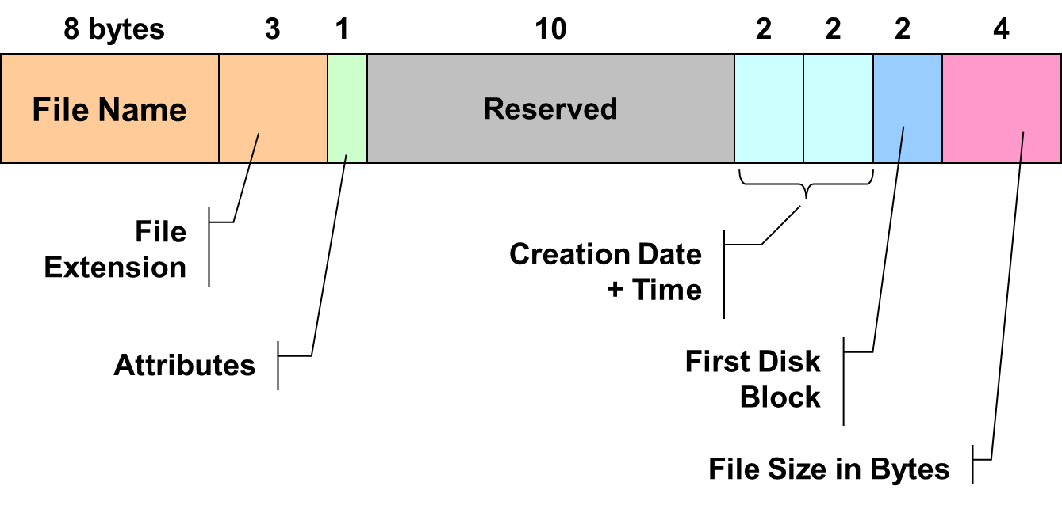
Variants: FAT12, FAT16 and FAT32
Main motivation:
Support larger hard disk as a single partition
Two major themes:
Disk Cluster:
Instead of using a single disk block as the smallest allocation unit
Use a number of contiguous disk blocks
FAT Size:
Bigger FAT ➔ More disk block/cluster ➔ More bits to represent each disk block/cluster
Existing variants:
FAT12, FAT16 and FAT32

Slide 14
FAT12, FAT16 and FAT32 (cont)
Generally, cluster size + FAT size determines the largest usable partition
Example (4KiB Cluster):
Note that the actual size is a little lesser:
Special values (EOF, FREE, etc) reduces total number of valid data block/cluster indices
FAT12 | FAT16 | FAT32
2¹² Clusters Largest partition: 4KiB * 2¹² = 16MiB | 2¹⁶ Clusters Largest partition: 4KiB * 2¹⁶ = 256MiB | 2²⁸ Clusters Largest partition: 4KiB * 2²⁸ = 1TiB

Slide 15
Cluster Size
Pros:
Larger cluster size ➔ Larger usable partition
Cons:
Larger cluster size ➔ Larger internal fragmentation
On FAT32, there are further limitations:
32-bit sector count ➔ Limited partition size
Only 28-bit is used in the disk block/cluster index

Slide 16
Long File Name Support
Virtual FAT (VFAT):
Support long filenames up to 255 characters
First used in Win 95 (FAT16)
A work around rather than redesign:
Use multiple directory entries for a file with long file name
Need to keep the 8+3 short version for backward compatibility

Slide 17
VFAT Entries: Illustration
"A long long file name.txt"
SQ
ile name.txt
SP
SQ
A long long f
SP
ALONGL~1.txt
Notes:
SQ = sequence number
SP = special invalid attribute

Slide 18
Extended-2 File System
Popular Linux File System

Slide 19
Extended-2 File System (Ext2)
One of the most popular file systems used in Linux
A nice case study:
Uses many techniques discussed
Embedded a few traditional Unix FS ideas
Serves as a good starting point to understand other Unix related FS
However, Ext2 is quite intricate:
Will concentrate on important/relevant parts only

Slide 20
Ext2 FS: Overview
Disk space is split into Blocks
Correspond to one or more disk sector
i.e. Similar to disk cluster in FAT FS
Blocks are grouped into Block Groups
Each file/directory is described by:
A single special structure known as I-Node (Index Node)
I-Node contains:
File metadata (access right, creation time etc)
Data block addresses

Slide 21
Ext2 FS: Layout
M B R
partition 1
partition 2
partition 3
partition 4
BOOT
Block Group 0
Block Group 1
Block Group 2
...
Group Descriptors
Data Blocks
Block Bitmap
Super-Block
I-node
Bitmap
I-node
Table
Notes:
Redundancy

Slide 22
Partition Information
Superblock
Describe the whole file system
Includes:
Total I-Nodes number, I-Nodes per group
Total disk blocks, Disk Blocks per group
etc
Duplicated in each block group for redundancy
Group Descriptors
Describe each of the block group
Number of free disk blocks, free I-nodes
Location of the bitmaps
Duplicated in each block group as well

Slide 23
Partition Information (cont)
Block Bitmap
Keep track of the usage status of blocks of this block group (1 = Occupied, 0 = Free )
I-Node Bitmap
Keep track of the usage status of I-Nodes of this block group (1 = Occupied, 0 = Free )
I-Node table
An array of I-Nodes
Each I-Node can be access by an unique index
Contains only I-Nodes of this block group

Slide 24
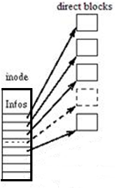
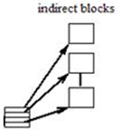
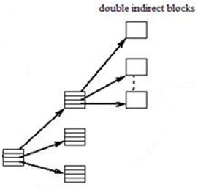
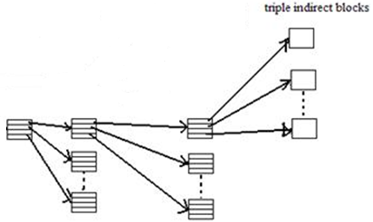
Ext2: I-Node Structure (128 Bytes)
I-Node
Table
Mode (2)
Owner Info (4)
File Size (4/8)
Timestamps (3 x 4)
Data Block Pointers (15 x 4)
Reference Count (2)
… Other …
… Fields …

Slide 25
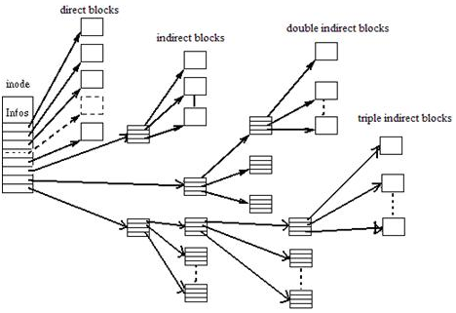
I-Node Structure: Data Blocks

Slide 26
I-Node Data Blocks
Other than file metadata, I-Node contains
15 disk block pointers (disk block number)
First 12 pointers:
Points to disk blocks that stores actual data
Known as the Direct Blocks
13th Pointer:
Points to a disk block that stores direct pointers
Known as Single Indirect Block

Slide 27
I-Node: Data Blocks (Cont)
14th Pointer:
Points to a disk block that contains a number of single indirect block
Known as Double Indirect Block
15th Pointer:
Points to a disk block that contains a number of double indirect block
Known as Triple Indirect Block

Slide 28
I-Node Data Block Example
The design of I-Node allows:
Fast access to small file
Flexibility in handling huge file
E.g. (4 bytes block address, 1KiB disk block)
Notes:
16GB

Slide 29
Directory Structure
Data blocks of a directory stores:
A linked list of directory entries for file/subdirectories information within this directory
Each directory entry contains:
I-Node number for that file/subdirectory
Size of this directory entry
For locating the next directory entry
Length of the file/subdirectory name
Type: File or Subdirectory
Other special file type is also possible
File/Subdirectory name (up to 255 characters)

Slide 30
Directory Structure (Illustration)
I-Node
Table
Data Blocks
91
F
4
Hi.c
39
F
8
lab5.pdf
74
D
3
sub
0
Notes:
Linked list like

Slide 31
Ext2: Putting The Parts Together
/sub/file (I-Node for '/' == 2)
File Metadata
8
D
3
sub
1
2
15
3
4
Disk Block 15
I-Node
5
File Metadata
6
7
6
F
4
file
23
8
…
…
Disk Block 20
I-Node
I-Node Table
File Metadata
Actual Data
20
I-Node
Disk Block 23
Notes:
make it similar to the example in FAT

Slide 32
Ext2 FS: Putting the parts together…..
Give a pathname, e.g. "/sub/file"
Let CurDir = "/"
Root directory usually has a fixed I-Node number (e.g. 2)
Read the actual I-Node
Look at the next part in pathname:
If it is a directory, e.g. "sub/"
Locate the directory entry in CurDir
Retrieve I-Node number, then read the actual I-Node
CurDir = next part in pathname
Goto Step 2.
Else //it is a file
Locate the directory entry in CurDir
Retrieve I-Node number, then read the actual I-Node

Slide 33
Common Task in Ext2: File Delete
Super
Block
Group Descriptors
Block
Bitmap
Inode
Bitmap
I-node
Table
Data Blocks
File Metadata
1
8
D
3
sub
2
15
3
4
I-Node
Disk Block 15
5
File Metadata
6
7
23
8
...
6
F
4
file
…
…
I-Node
Disk Block 20
I-Node Table
File Metadata
Actual Data
/sub/file
20
I-Node
Disk Block 23
Notes:
Question: Can Undelete? System crashes?

Slide 34
Hard / Symbolic Link with I-Node
Scenario:
Directory A contains file X, with I-Node# XN
Directory B wants to share X

Slide 35
Hard / Symbolic Link
8
F
1
X
...
...
Directory Entries for directory A/
Reference Count
I-Node No. 8
8
F
1
Z
Directory Entries for directory B/
Hard Link created for B/
File Metadata
Go to /A/X
123
13
F
1
Y
Content of file Y
Directory Entries for directory B/
I-Node No. 13
Symbolic Link created for B/

Slide 36
Ext2 FS: Hard Link and Symbolic Link
Hard Link problems:
With multiple references of a I-Node, it is hard to determine when to delete an I-Node
Maintain a I-Node reference count
Decremented for every deletion
Symbolic Link problems:
As only the pathname is stored, the link can be easily invalidated:
File name changes, file deletion etc
Involve a search to locate actual I-Node number of target file
Just like a normal file opening operation

Slide 37
EXTRA TOPICS
Extra Value!

Slide 38
File System Consistency Check
Power loss / system crash can render the file system in an inconsistent state
Tools for checking consistency:
Windows: CHKDSK
Linux: fsck
What are the issues can be found / fixed by such tools?

Slide 39
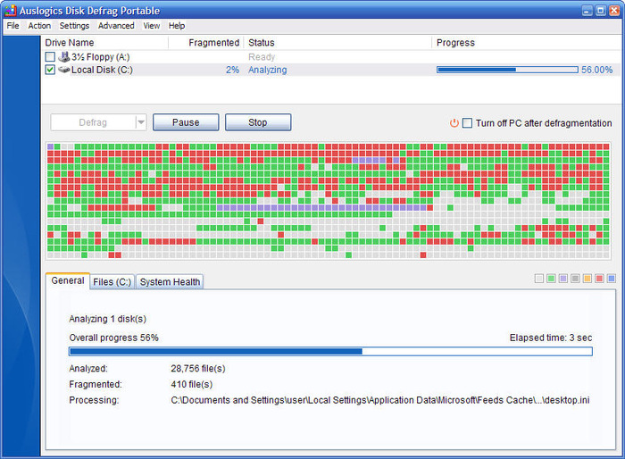
Defragmentation
Fragmentation:
File data can be scattered across many disjoint blocks on storage media
In Windows:
Official and 3rd party software to alleviate the problem
In Linux:
File allocation algorithm is more intelligent:
Files are allocated further apart
Free blocks near to existing data block are use if possible
Fragmentation is very low when the drive occupancy is < ~90%

Slide 40
Journaling
Keep additional information to recover from system crash
Basic Idea:
Write the information and / or the actual data into a separate log file
Perform the actual file operation
Depending on the information logged:
Can recover to an earlier stable state or re-perform the interrupted file operation
Most current file systems support journaling in some fashion

Slide 41
Interesting/Important File Systems (1/3)
Virtual File System (VFS)
Provides another layer of abstraction on top of existing file systems
Allow application to access file on different file systems
File operations are translated by VFS automatically to the corresponding native file system
Network File System (NFS)
Allows files to reside on different physical machine
File operations are translated into network operations

Slide 42
Interesting/Important File Systems (2/3)
New Technology File System (NTFS)
Used in WinXP onwards
Some features:
File Encryption, File Compression
Versioning (different versions of a file is kept)
Hard/Symbolic Link
Extended-3 / 4 File System (Ext3 / Ext4)
Variant on the Ext2 FS
Support:
Journaling (Keep track of changes to file)
In-place upgrade from Ext2
Expanded maximum file and file system size

Slide 43
Interesting/Important File Systems (3/3)
Hierarchical File System Plus (HFS+)
Used in Mac OS X
Some features:
Compression, encryption support
Large file system, file and number of file/folder support
Metadata journaling

Slide 44
Summary
Covered the FAT file system
Implementation and Limitation
Variants FAT12, FAT16 and FAT32
Covered the Ext2 file system
Design and Limitation
I-Node structure
Discussed a number of related topics / ideas
More current file systems

Slide 45
Generic Layout (Lecture 11)
OS Boot Block
Partition Details
Directory Structure
Files Info
File Data
E

Slide 46

Microsoft FAT File System
I wrote FAT12 in Five days back in 1976….
E

Slide 47
Stop & Check : FAT
root
directory
Boot
data blocks
FAT
FAT
Duplicate
OS Boot Block
Partition Details
Directory Structure
Files Info
File Data
E

Slide 48
Example of Common Tasks: Free Space
0
0
1
1
BAD
2
2
EOF
ex1.c
3
3
3
5
ex2.c
6
4
4
FREE
test/
2
5
5
8
6
...
6
7
7
7
EOF
8
8
EOF
9
9
FREE
…
…
…
Directory Entries
(in a Disk Data Block)
FAT
(in RAM)
Data Blocks
(in Disk)
E

Slide 49

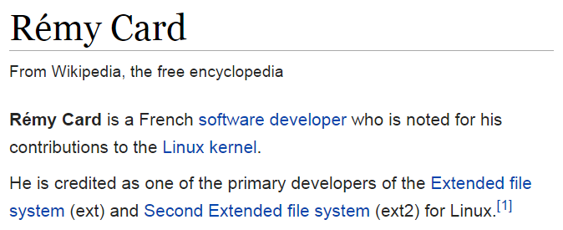
Extended-2 File System (Ext2)
Hi, my name is Rémy Card
Ya, I know. Not as sexy….☺
E

Slide 50
Stop & Check: Ext2
BOOT
Block Group 0
Block Group 1
Block Group 2
...
Super- Block
Group Descriptors
Block BM
I-node BM
I-node Table
Data Blocks
OS Boot Block
Partition Details
Directory Structure
Files Info
File Data
E

Slide 51
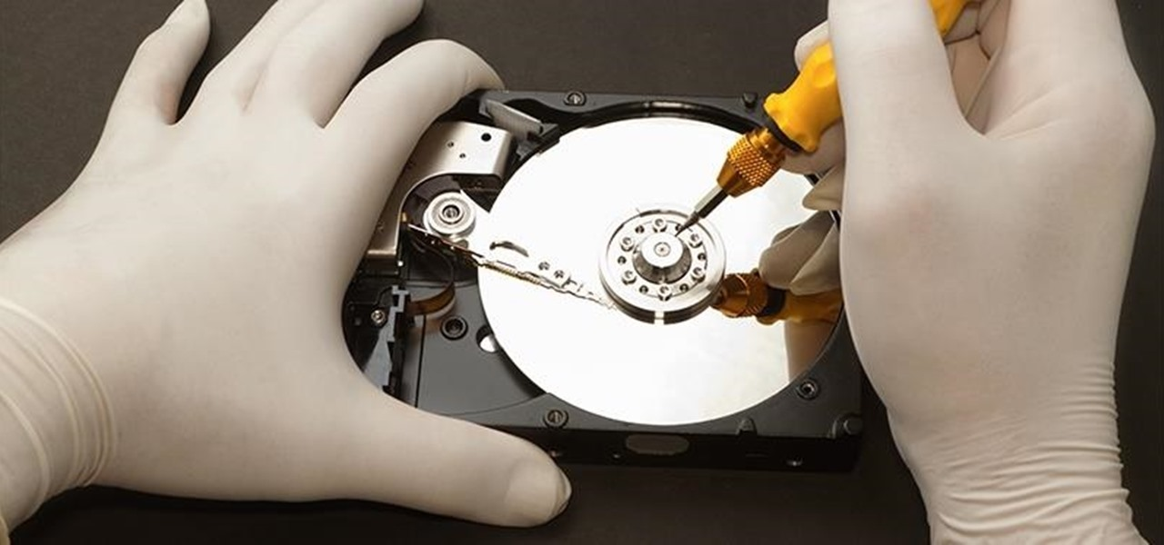
E

Slide 52
FAT File System
FAT
FAT
Duplicate
optional
Boot
root
directory
data blocks
E

Slide 53
Extended-2 File System
BOOT
Block Group 0
Block Group 1
Block Group 2
...
Group Descriptors
Data Blocks
Block Bitmap
Super-Block
I-node
Bitmap
I-node
Table
E

Slide 54
Common Task in Ext2: File Delete
File Metadata
1
8
D
3
sub
2
15
3
4
I-Node
Disk Block 15
5
File Metadata
6
7
23
8
...
6
F
4
file
…
…
I-Node
Disk Block 20
I-Node Table
File Metadata
Actual Data
/sub/file
20
Disk Block 23
E
I-Node
Notes:
Question: Can Undelete? System crashes?

Slide 55
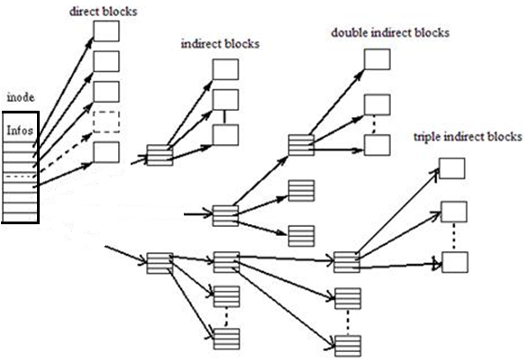
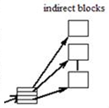
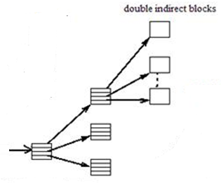
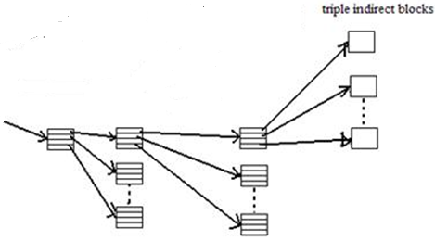

Slide 56
root
directory
Boot
data blocks
FAT
FAT
Duplicate
OS Boot Block
Partition Details
Directory Structure
Files Info
File Data

Slide 57
Stop & Check
BOOT
Block Group 0
Block Group 1
Block Group 2
...
Super- Block
Group Descriptors
Block BM
I-node BM
I-node Table
Data Blocks
OS Boot Block
Partition Details
Directory Structure
Files Info
File Data
E

